Slide 1
Problem Statement
Smart Waste Segregation and Recycling System
This problem statement centers on developing a system that automates waste segregation and recycling, aligning perfectly with your project idea. By integrating IoT-enabled smart dustbins capable of detecting, segregating, and weighing waste, along with a reward-based incentive system, your solution addresses this challenge effectively and innovatively

Slide 2
Features
Automatic Waste Detection & Segregation – Smart sensors identify and separate waste.
Real-Time Weight Measurement – Tracks how much waste is deposited.
IoT & Cloud Integration – Data stored and accessible online.
Reward-Based Incentives – Encourages responsible disposal with points or rewards.
User-Friendly Interface – Mobile app or dashboard for monitoring.
Environmentally Impactful – Promotes recycling and reduces landfill waste

Slide 3


USe Me
Me USe

Slide 4
JuSt Earn
With me

Slide 5


WASTE
TO
MONEY

Slide 6


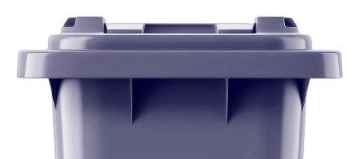
Frontend
Put waste
Enter ID Earn cash

Slide 7
Backend
Separate waste
Measure weight
Stores waste

Slide 8
Detect the waste using the sensor and seperate the waste
From the container the waste are pushed to the weight load line by line to measure the weight
The measured waste are aligned in seperate container for recycling

Slide 9
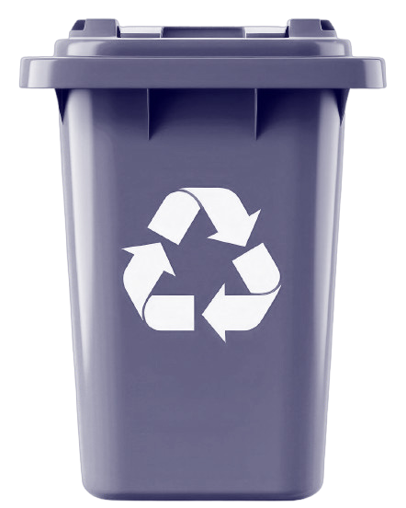
The sensor sence the waste and pull the waste line by line
Waste detect
| 1(Metal) 2(Plastic)
3(Wood or other)
|
Weight cell load

Slide 10

Weight Load measure the waste One by One and credict coin
1(Metal)
|
2kg - stored in cloud
|
Pull waste to [1,2,3] container
|
waiting for 2(plastic)

Slide 11
The motor rolls using the signal of controller and collect the waste in 3 containers
Metal: Canes,Aluminium wires
Plastics:
Printing filaments,toys
Wood: Furnitures,Fertizilers
This waste are Recycled by thier type for different use case

Slide 12
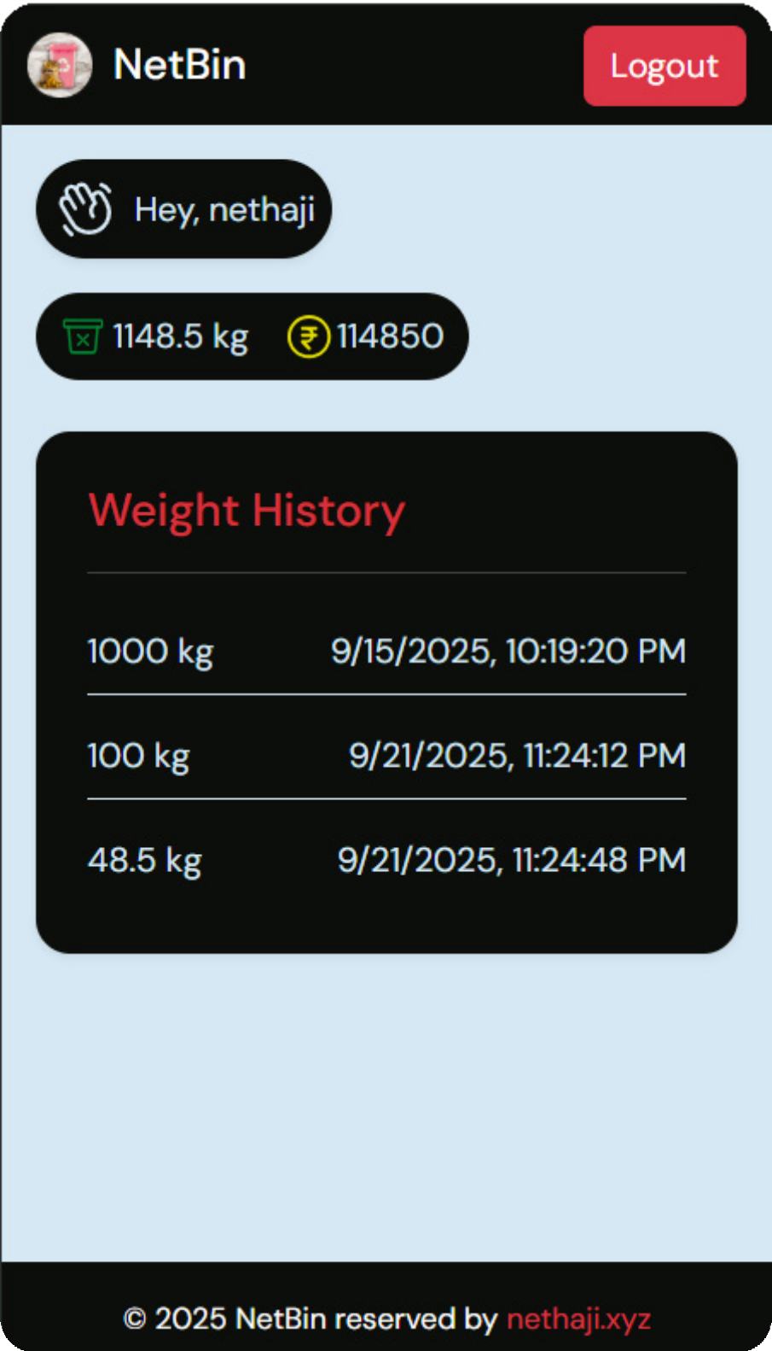
Also an dashboard feature also for the user to track their Histroy and See their earnings

Slide 13
Tools & Technology
Hardware: ESP32, Ultrasonic/IR Sensors, Load Cell, Servo Motors, Mechnical components
Software: React-based Website
Cloud: Firebase
Connectivity: Wi-Fi / IoT modules for real-time data transfer
Analytics & Dashboard: Cloud-based monitoring and reporting

Slide 14
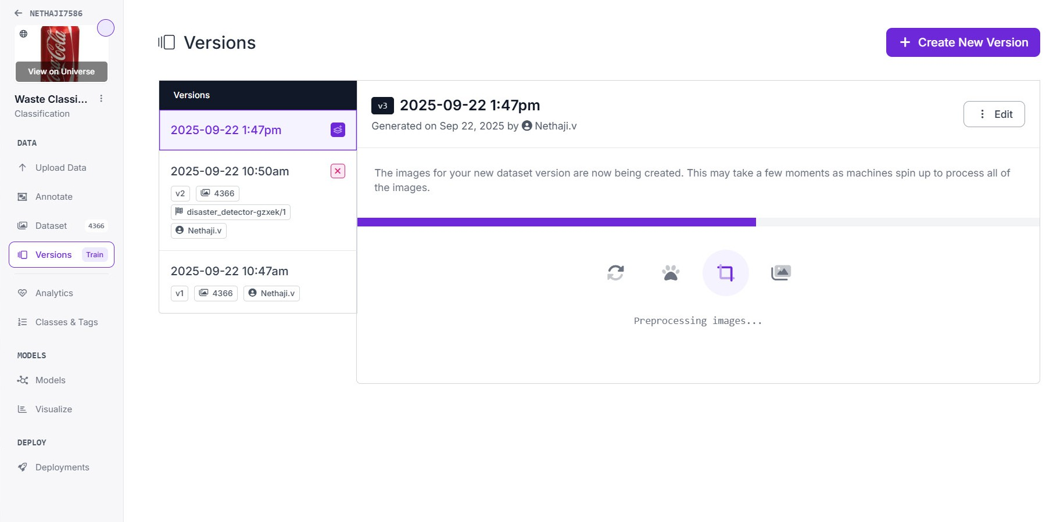
Tools & Technology Advance
Using camera the machine learning model can classify the waste and seperate the waste into different.We also train an model for classification

